Slide 1
Charging Station Upgrade to OCPP Communication for Smart Charging
reported by Junfan Jin, Can Zeng,
Yunan Jiang and Huang Chen
ADP /Darmstadt/05.12.2025

Slide 2
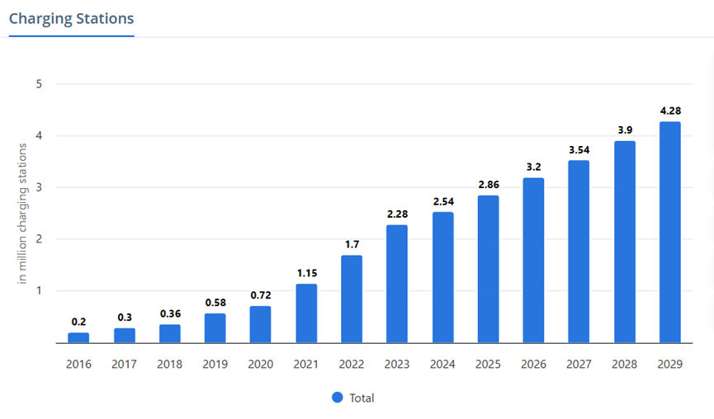
Background
1. Increasing number of
EVs & Charging Stations
2. In Germany, “plug and
charge” mode of 10 million
EVs by 2035 increase 50%
in low-voltage grid and
transformer costs [1]
[2]

Slide 3
Significance
Peak shaving
Variable charging rate
OCPP
Decrease overload of grid
Electricity price
Battery capacity
Open source

Slide 4
Objectives
1. Upgrade the old charge point to support the OCPP communication protocol
2. Complete the construction of a prototype of a smart charging system
3. Remotely control the charging process
4. Test and debug the functions of the smart charge point

Slide 5
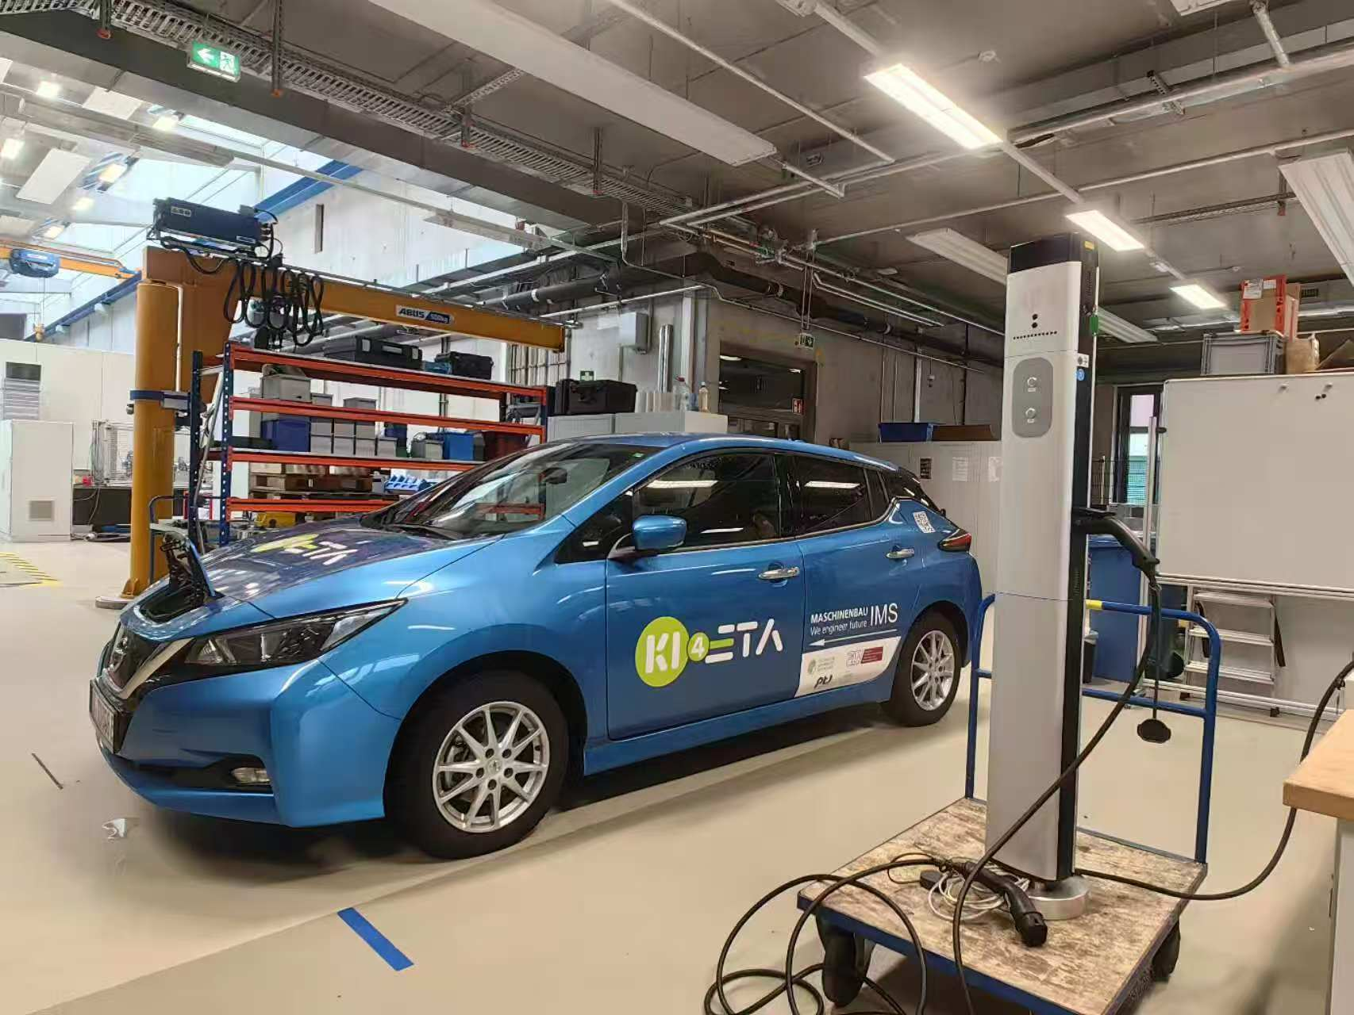
Problems during Testing
No indicator for charge point
Solution:
Always on
Fast blinking
Slow blinking
Blinks 2 times
2. Modbus port allows only one thread at one time
Solution:
first, serialize access using thread lock
then, ensure globlally unique access
with singelton pattern

Slide 6
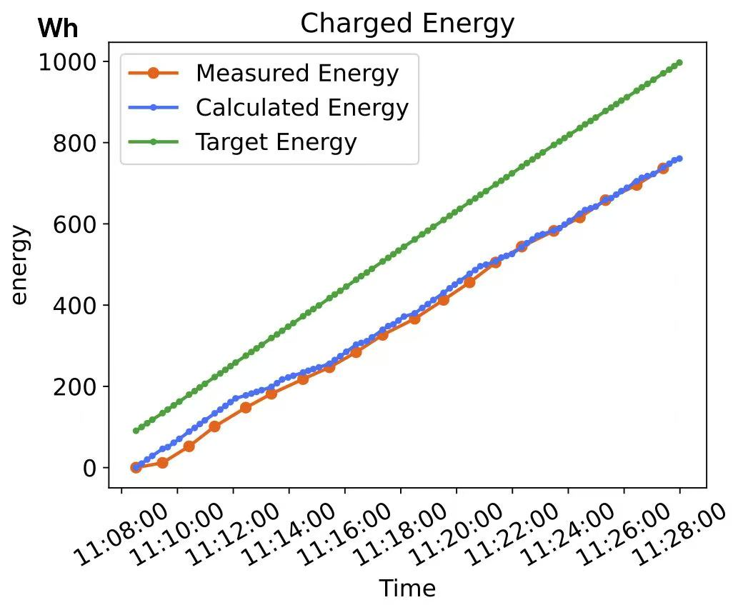
Conclusions
1. Results
1.1 Charging point control and optimization
different modes: directly charging or
using charging schedule
1.2 Data visualization

Slide 7
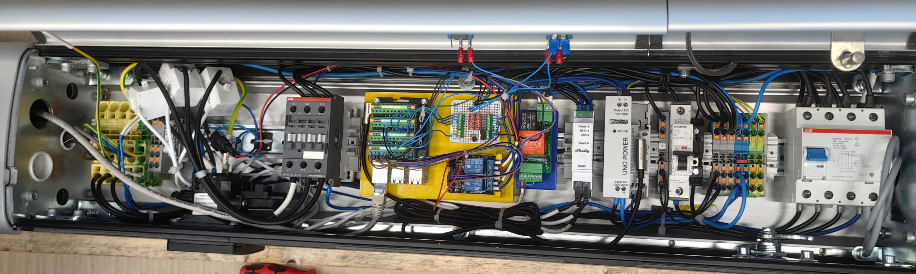
Conclusions
1.3 Communication between charge point and optimizer
1.4 GUI Design including charging status, log information and control operations
1.5 Simulator Design
1.6 Hardware modification (Raspberry Pi, Shelly, relay for DC-motor and LED-indicator)

Slide 8
Conclusions
2. Prospect
OCPP Python Library
Current Monitoring and
Safety Control
Limited Web Terminal Message Display
Database Support
Multiple Ports

Slide 9
Literature
[1] https://www.statista.com/outlook/mmo/electric Electric Vehicles.url:vehicles/worldwide
(visited on 01/2025).
[2] International Renewable Energy Agency(IRENA). Innovation Outlook Smart Charging For Electric Vehicles.Tech. rep. International Renewable Energy Agency(IRENA), 2019

Slide 10
Thank you
for your Attention

